Slide 1

Analysis of 2024 Election Data
Presented By: Sherin P V
Batch No: MIP-DA-11

Slide 2
Objective:
The objective of this analysis is to gain insights into the 2024 election results, party performance, and voter trends across various constituencies. Interactive visualizations and dashboards created using Power BI will help stakeholders understand the election outcomes and the dynamics between different political alliances.

Slide 3
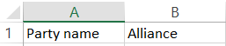
Dataset Overview
1. Election Results Data:
2. Party Alliance Data:

Slide 4
Tasks:
1. Data Integration:
2. Data Cleaning and Preparation:
3. Data Analysis and Visualization:
4. Interactive Dashboard:
5. Insights and Recommendations:

Slide 5
TASK 1: Data Integration
1. Election Results Data:
2. Party Alliance Data:
3. Integrated Data’s

Slide 6
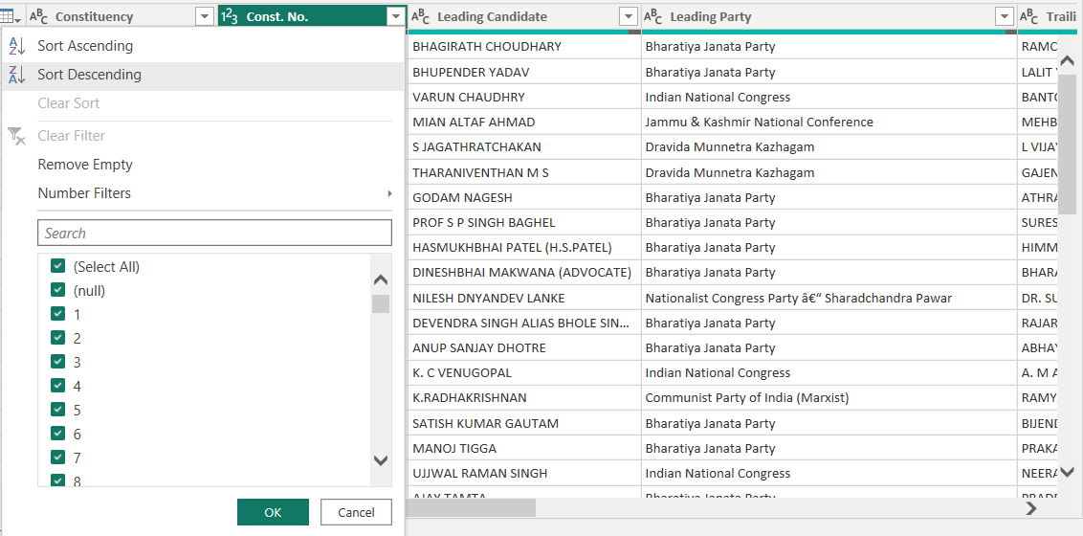
TASK 2: Data Cleaning and Preparation

Slide 7
TASK 3: Data Analysis and Visualization
- Overall Results: Create a summary of the overall election results including the total number of seats
won by each party and alliance.
- State-wise Analysis: Visualize the performance of leading parties and alliances across different states.
- Constituency-wise Analysis: Analyze and visualize the margin of victory/defeat in various
constituencies.
- Party and Alliance Comparison: Compare the performance of different parties and their respective
alliances in terms of seats won, margins, and status.
- Trend Analysis: Identify and visualize trends in voting patterns, such as regions with high competition
(small margins) or dominance by specific parties or alliances.

Slide 8
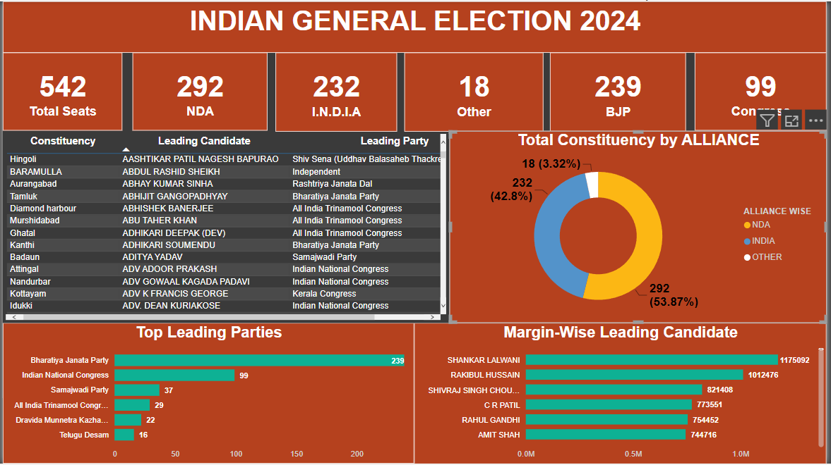
TASK 4: Interactive Dashboard

Slide 9
TASK 5: Insights and Recommendations
Insight: Key Margins of Victory
Observation: Candidates from NDA have won with significant margins in various constituencies.
Key Detail: Large victory margins highlight areas where the party has strong support.
Recommendation:
For NDA: Utilize the success in high-margin constituencies to reinforce strongholds and replicate successful strategies in other areas. Ensure continued focus on high-support regions to maintain and build upon existing strengths.

Slide 10
THANK YOU!
Feel Free to Connect
LinkedIN– sherin-pv

